Slide 1
Getting Started in Beekeeping
Brown County Beekeepers Association

Slide 2
Agenda
Honeybee basics
History
Bee supplies and equipment
Bee sources
Location and registration
Goals for the new beekeeper
Alternative beekeeping methods

Slide 3
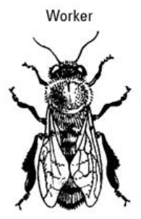
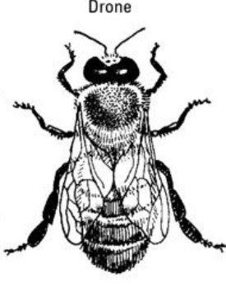
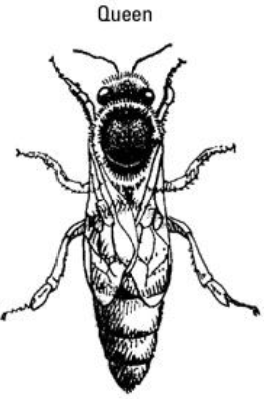
Who are the Bees and their Duties
Colony is 99% female
Workers - females with various duties throughout colony
Cleaning; nursing young; security; care for the Queen, foraging, etc
Drones – Males. Only duty is to mate with a queen
Queen Bee – Most important bee in the colony

Slide 4
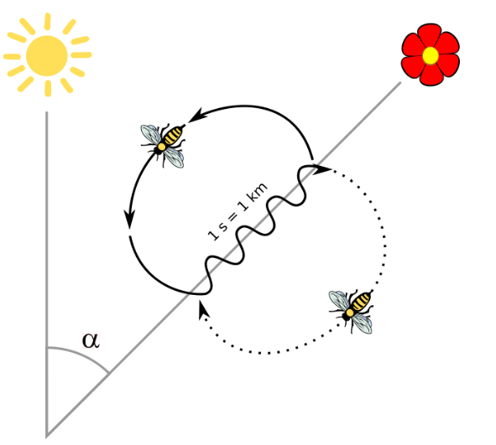
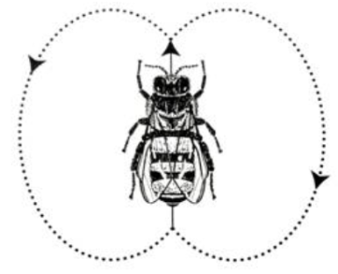
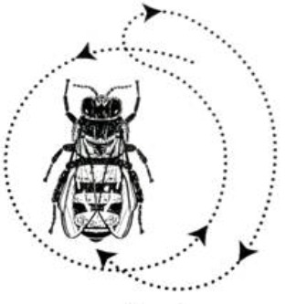
Bee Communication
Pheromones
Queen’s scents
Alarm/Alert scents
Waggle Dance
Indicates direction and distance information of nectar/pollen source to other bees
For distances 150 yds to a couple miles away
Circle or Round Dance
Indicates direction and distance information of nectar/pollen sources that are generally closer (0~100 yds)

Slide 5
Products of the Bee Hive
Honey
All natural sweetener
Beeswax
Used for furniture polish, cosmetics, creams, candles, etc
Propolis
Used in medicine for its antibacterial and antifungal properties
Pollen
Used by herbalists as a treatment for a variety of medical conditions such as allergies
Royal Jelly
Collected and sold as a dietary supplement

Slide 6
How Many Bees in the Hive?
Spring
Population builds up for swarming and nectar flow
Summer
Population peaks 60,000 ~ 80,000
Fall
Population declines; Drones cast out
Winter
Population at lowest during year 10,000 ~ 15,000

Slide 7
Bee Breeds and Qualities
Types of Bees
Italians
Russians
Carniolans
Caucasians
Buckfast
Africanized
Qualities of different Breeds:
Gentleness
Spring build-up
Over-wintering ability
Swarming
Propolis
Disease resistance

Slide 8
Bee Characteristics

Slide 9
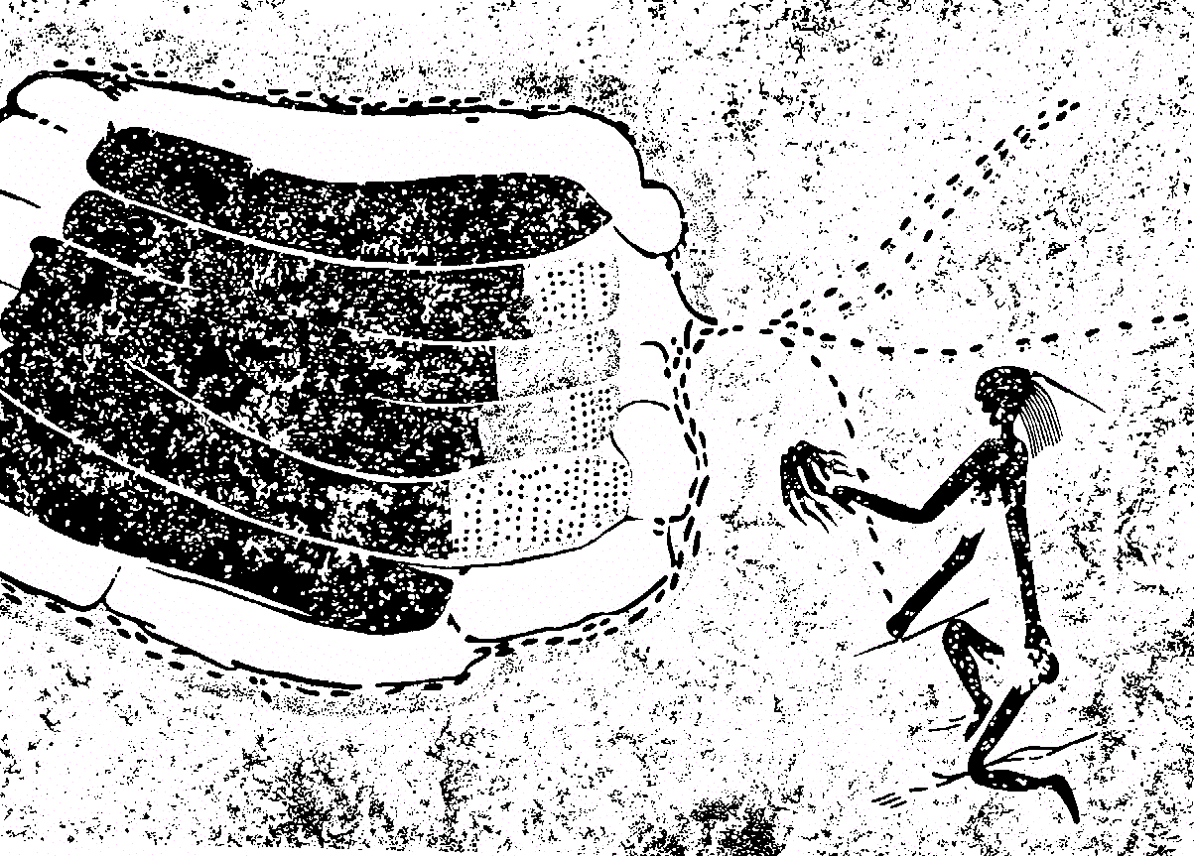
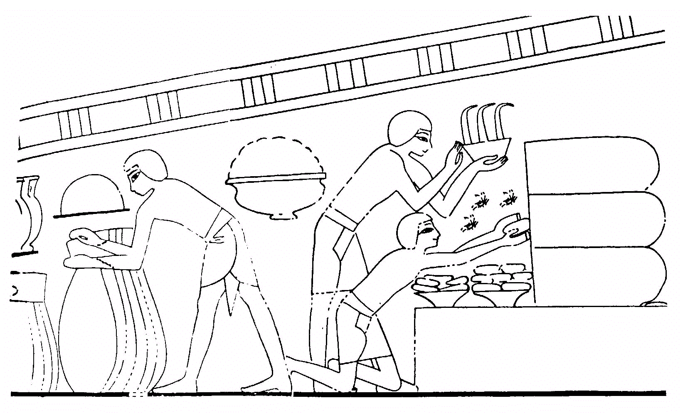
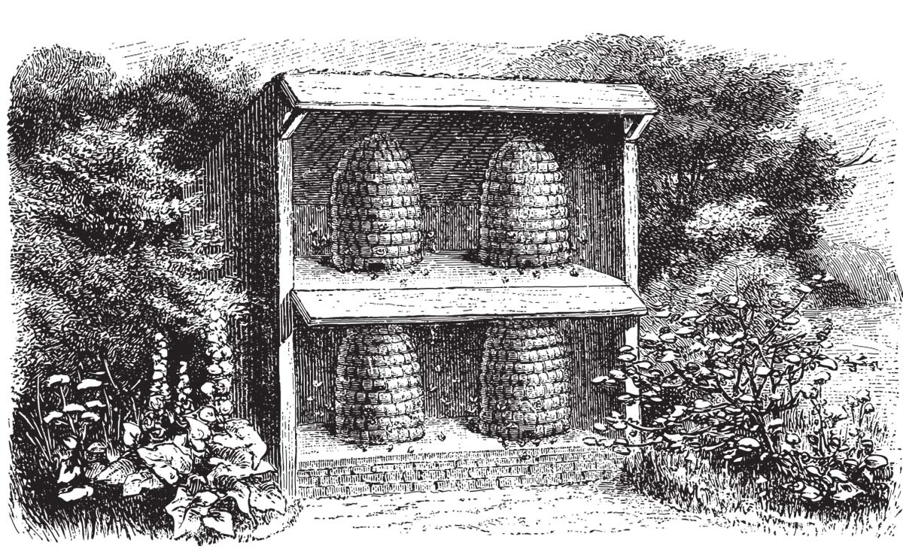
History of Honey Gathering
Cavemen – cave paintings; circa 10,000 BC
Egyptians – paintings in tombs; circa 2,000 BC
Raising colonies in Hollow Trees, Clay Jars, and Woven Skeps

Slide 10
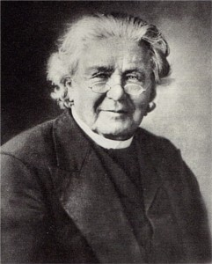
Beginning of Modern Beekeeping
1851 – Rev Lorenzo Langstroth
Discovered Bee Space (3/8”)
Space needed by a bee to pass easily between two structures . If space is too small, bees will seal it with propolis
Developed new type of bee hive
Removable frames
Interchangeable parts
Revolutionized beekeeping
Allowed inspection and harvesting without destroying hive

Slide 11
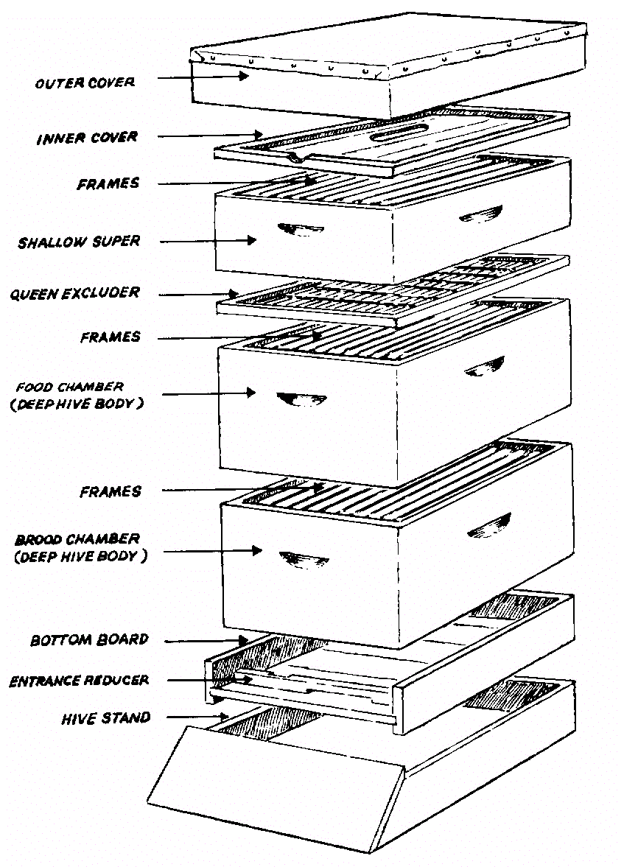
Langstroth Hive Components
Outer Cover
Inner Cover
Honey Supers (Shallow)
Queen Excluder
Food Chamber (Deep)
Brood Chamber (Deep)
Bottom Board
Hive Stand

Slide 12
Beekeeping Equipment and Supplies
Several sources for woodenware and equipment
Local:
Higgins Steel Roofing, Hillsboro (937-364-2331)
Bethel Feed & Supply, Bethel (513-734-2246)
Grant’s Farm, Williamsburg (513-625-9441)
Dana Bee Farm, Aberdeen (606-584-8376)
Regional/National:
Dadant and Sons (www.dadant.com)
Kelley Bees (www.kelleybees.com)
Simpson Bee Supply (www.simpsonsbeesupply.com)
Betterbee (www.betterbee.com)
Blue Sky Bee Supply (www.blueskybeesupply.com)
Miller Bee Supply (www. millerbeesupply.com)
Brushy Mountain (www.brushymountainbeefarm.com)
Mann Lake (www.mannlakeltd.com)

Slide 13
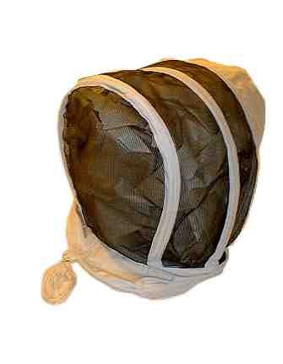
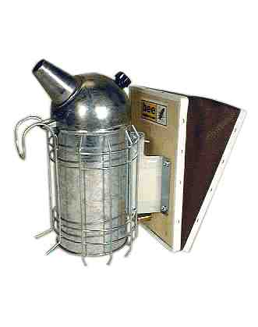
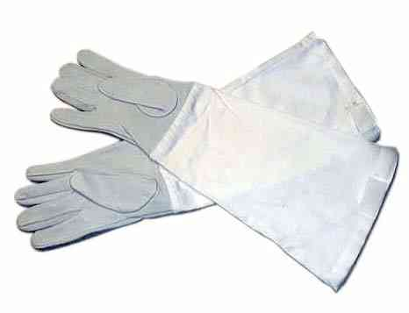
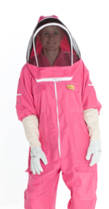
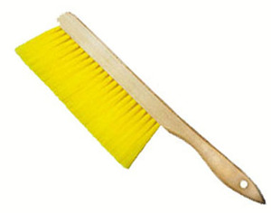
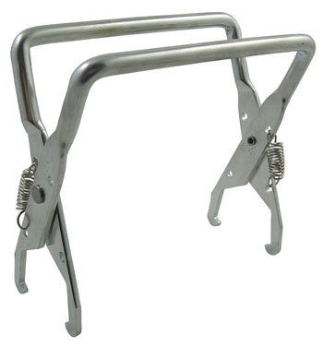
Tools and Protective Equipment Required
Bee suit or light color clothing
Veil
Gloves
Smoker
Hive Tool
Bee Brush
Frame Grippers

Slide 14
Bee Hive Parts List, Tools, Equipment, and Protective Gear
Tools, Equipment and Protective Gear
Item | Qty | Remarks
Smoker | 1 | Used to smoke the bee hive prior to entry; calms the bees.
Hive Tool | 1 | Used for prying apart hive bodies, removing frames, scraping, etc.
Frame Grippers | 1 | Used to remove frames from hive body.
Bee Brush | 1 | Handy brush that gently sweeps bees out of your way while inside hive or trying to replace covers, etc.
Bee Gloves | 1 pair | Many styles exist. Find a pair that provides protection against stings while permitting dexterity while inside hive.
Veil | 1 | Many beekeepers prefer a bee jacket or complete suit. Get an item that provides the most comfort as well as protection.
Note: Many national beekeeping suppliers offer a "Beginners Kit" that contain most of the items needed to keep bees. Most are effective and offer a cost savings to those starting out. Don’t overlook these kits as an option to procuring your initial set of tools and equipment.
Hive Components
Item | Qty | Remarks
Bottom Board | 1 | Serves as the base for the bee hive. Many beekeepers prefer a screened bottom board to a solid board as it can help reduce the varroa mite population within the hive and offer greater ventilation.
Deep Body (9 5/8") | 2 | Two of these will be needed to serve as the brood chamber and food storage for the colony.
Inner Cover | 1 | This cover sits atop the hive body but under the outer cover/telescoping cover. It has many uses, but one primary purpose is to prevent the bees from propolizing the outer cover to the hive.
Telescoping Cover | 1 | The roof for the hive.
Entrance Reducer | 1 | This restricts the entrance size of the hive. Usually, they are reversible to allow two different sized openings
Foundation | 20 | Several types of foundation are available; wax, crimp wire wax, plastic, etc. The traditional product is wired wax foundation; however, the plastic (plasticell) may be easier to install.
Deep Frame | 20 | Ensure you buy the correct type of frames that match your type of foundation.
Frame wire | 1/2 lb | This is required when using wax foundation. It supports the wax laterally across the frame and is installed after foundation is placed into the frame.
Entrance Feeder | 1 | Used to feed the bees sugar syrup. Many beekeepers prefer top feeders.
Nails | Various | Generally, nails are included with hive components and frames.
Wood Glue | 4oz | Recommend a good quality waterproof wood glue such as Titebond III.
Latex Paint | 1/2 gal | Many beekeepers find their latex at the Mis-tint section of their local hardware store…
Note: The above list assumes the beekeeper will begin with a standard 10-Frame Deep Langstroth Hive. If desiring to use Medium supers or 8-frame equipment, the list will be different.

Slide 15
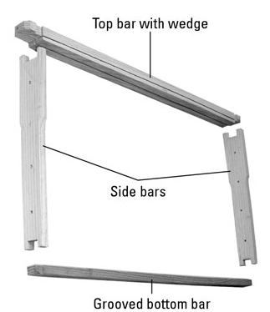
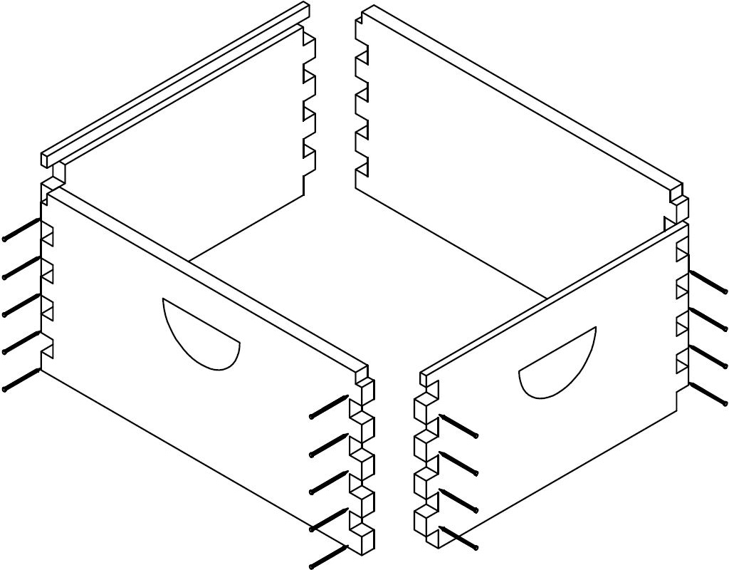
Assembling Hive
Nails and Glue (waterproof glue preferred)
Latex paint on outside of components
Color optional

Slide 16
Hive Location and Registration
Is it legal?
Be a good neighbor
Location abundant with beneficial plants
Access to clean water
Not on top of a hill nor in valley
Access to morning sun and south/southeast facing orientation; full sun is best
Ohio Beekeepers must register their hives with the Ohio Department of Agriculture by 1 Jun 2017
http://www.agri.ohio.gov/divs/plant/apiary/apiary.aspx

Slide 17
Due by Jun 1
Each beekeeper must complete one Registration form
Multiple apiaries (sites) can be submitted on one form
Each location costs $5
This supports the State/County inspection program
Authority Ohio Revised Code section 909.02

Slide 18
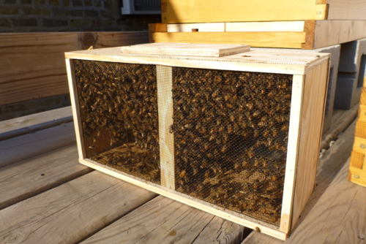
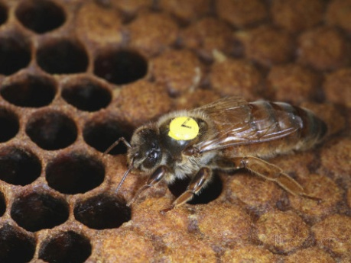
How you can get bees
Order a ‘package’ of bees
3 lb package; roughly 11,000 bees
Buy a Nuc colony
Pre-established 5-Frame colony
Purchase an established colony
Capture a wild swarm of bees
Note: when buying it may be a good idea to get a ‘Marked Queen’

Slide 19
Where you can purchase bees
Waldo Ohio Apiaries (Ashley OH)
www.waldobees.com
Tony Rimkus (Tipp City OH)
www.olddrone.com
Gaiser Bee Company (Cincinnati OH)
www.gaiserbeeco.com Ph 513-673-0503 / 810-618-2646
Schoolhouse Bees (Spille’s Honey) (Visalia KY)
www.schoolhousebees.com Ph:(859) 356-1350
Simpson's Bee Supply (Danville OH)
www.simpsonsbeesupply.com
Guthrie’s Naturals (Dadant in Frankfort KY)
www.guthriesnaturals.com
Jim Coss (Moorhead KY)
www.thehoneyandbeeconnection.com
Kelley Beekeeping (Clarkson KY)
www.kelleybees.com
Ohio State Beekeepers Association has a decent listing of bee suppliers on their site: www.ohiostatebeekeepers.org
Or perform an internet search for “package bees for sale”

Slide 20
Installing Bees from a Package
Make-up of package:
Queen in cage; can of sugar syrup; 11,000 honey bees
To install bees into assembled hive:
Open bee package; remove syrup can and queen cage; set cage into hive body
Prepare (remove cork) and install queen in cage between remaining frames
After 4~5 days:
Check that queen is released
Remove empty bee package and empty queen cage

Slide 21
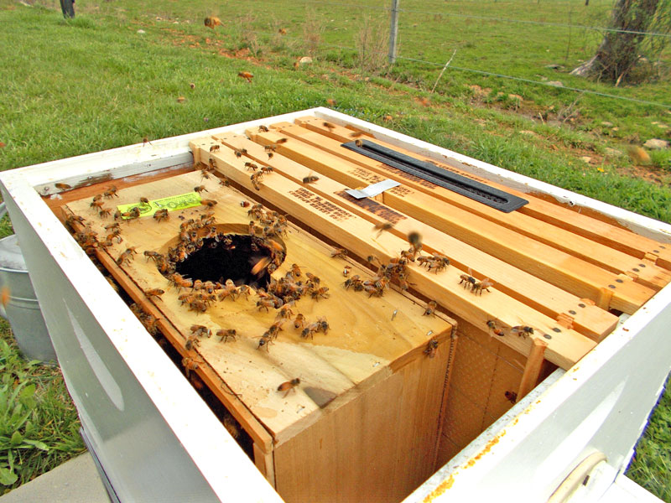
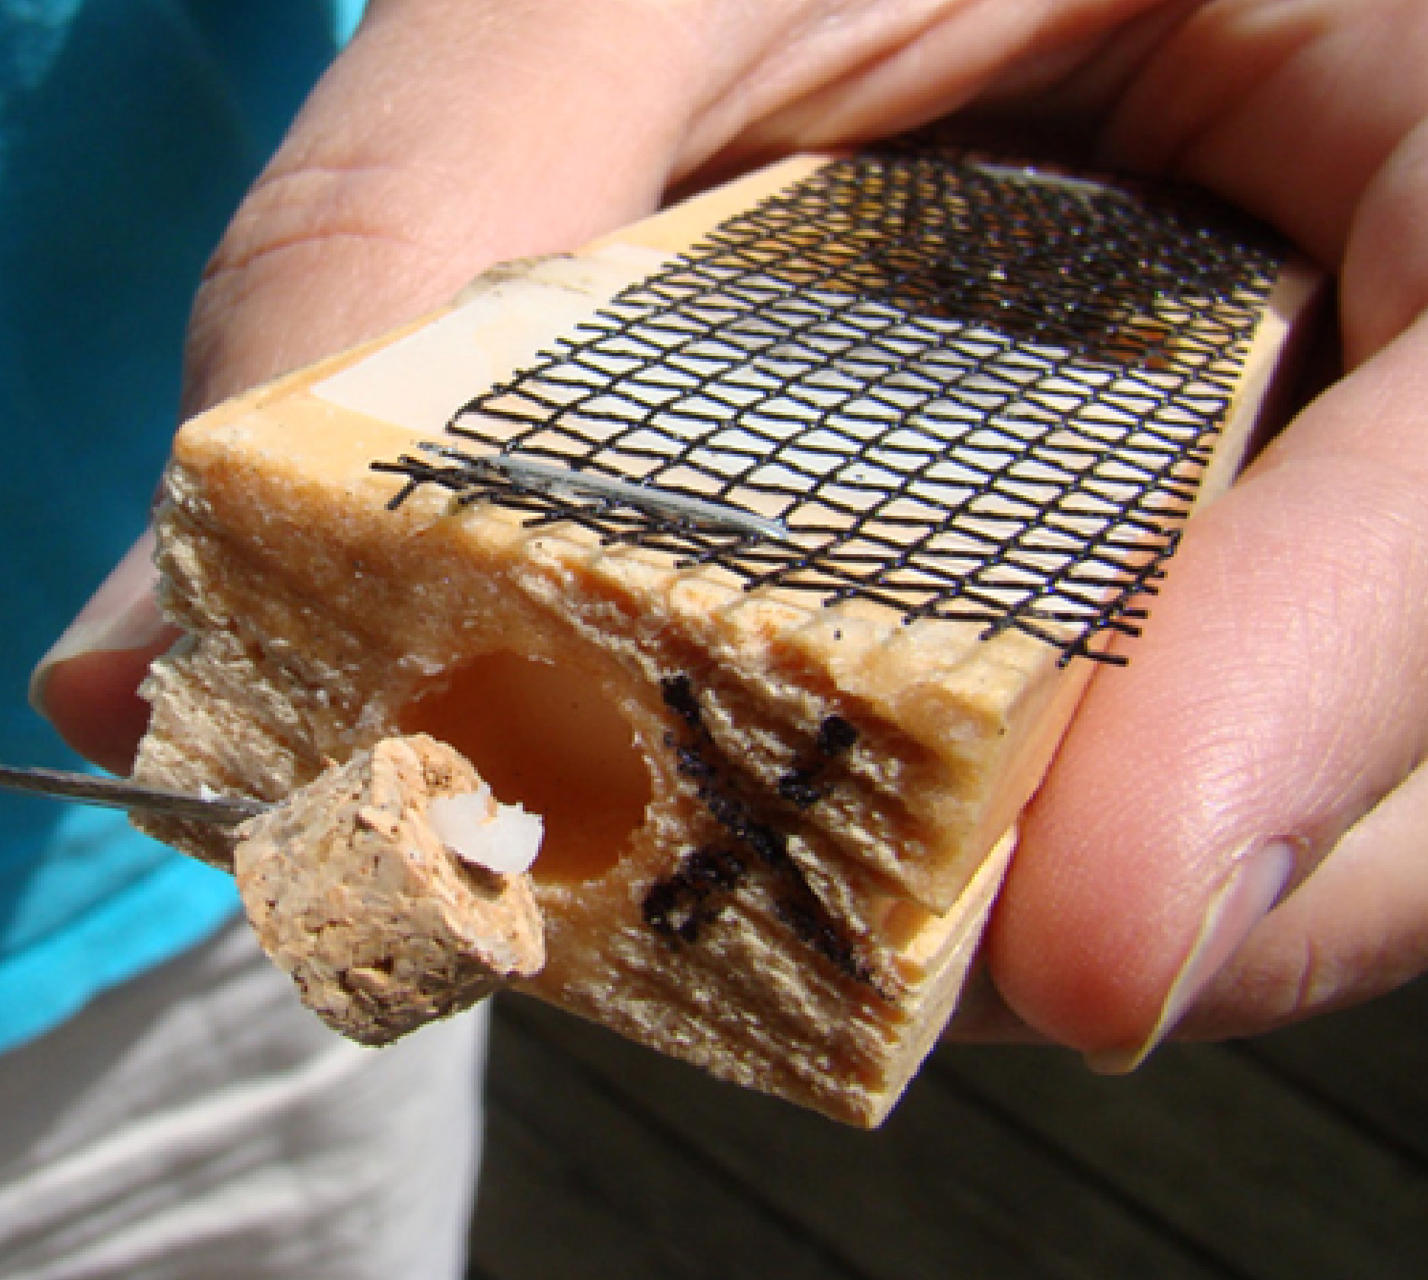
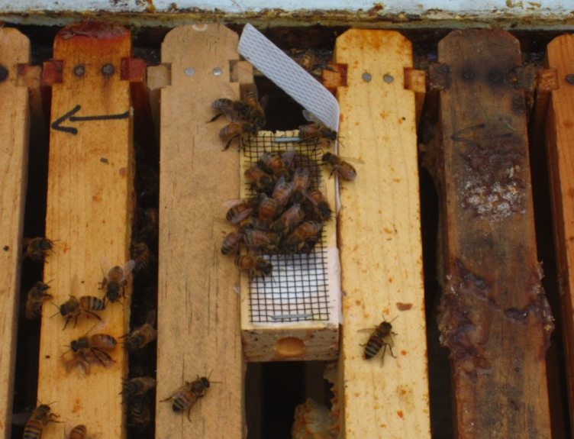
Package Installation
Bee Package
Queen Cage

Slide 22
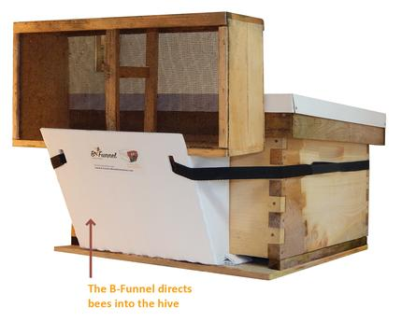
Other installation methods

Slide 23
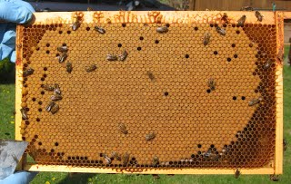
1st Year Goals
Observe and learn
Learn from the bees
Research, read, attend bee school, etc
Inspect hives periodically
Use checklist and keep records
Facilitate growth and expansion of colony
Add deeps/supers commensurate with colony size
Ensure bees have enough space to grow from ~11,000 bees to 50,000 ~ 60,000 bees during spring/summer
Help the bees survive their first winter
The bees will need 60-70 pounds of honey for winter
May have to provide supplemental feeding
Normally no surplus for beekeeper during 1st year

Slide 24
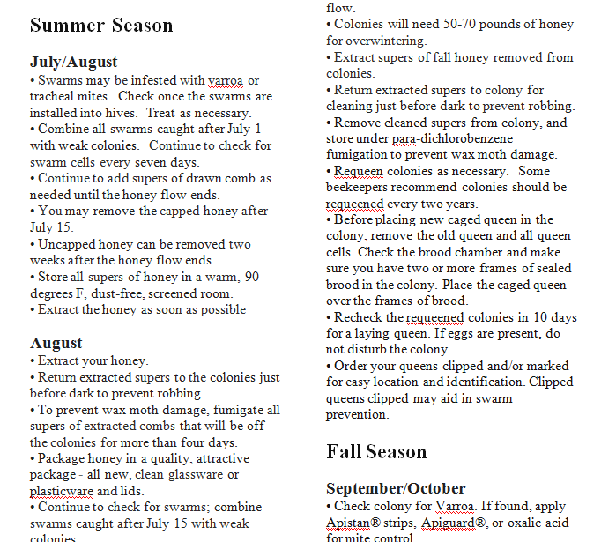
Beekeeper’s Calendar / Seasonal Management
See Handout

Slide 25
Sample Checklist
Hive number/location_____________________
Date of this inspection_____________________
Date queen/hive was established______________
Observations | Notations
Observe bees at entrance. (Look for dead bees or abnormal behavior and appearance.)
Do you see significant “spotting” of feces on the hive? (If yes, the bees may have Nosema and need to be medicated.)
What is the condition of your equipment? (Note any needed repairs that have to be made or replacement parts to order.)
Do you see eggs? (You should find only one egg per cell.)
Can you find the queen? (Is she the same “marked” one you introduced?)
How’s the brood pattern? (It should be compact and plentiful during the brood rearing season.)
Evaluate your queen based on her egg-laying ability. (Do you need to replace her with a new queen?)
How do the larvae look? (Larvae should be a glistening, snowy white.)
Check for swarm cells. (Take swarm prevention steps, if needed.)
Check for supercedure cells. (May be an indication that your queen is underperforming and needs to be replaced.)
Check appearance of brood cappings. (Cappings should be slightly convex and free of perforations.)
Is the colony healthy? (You should find lots of active bees, healthy-looking brood, a clean hive, and a nice sweet smell.)
Do you see evidence of Varroa mites (on bees on sticky board)? If yes, take corrective action accordingly.
Observe bees on the ground in front of the hive. Do they appear to be staggering or crawling up grass blades and then falling off? If yes, this may be an indication of a virus or tracheal mites. Take steps accordingly.
Do the bees have food? (They need honey, pollen, and nectar.)
How much capped honey is there? (Is it time to add a queen excluder and honey supers?)
Do the bees have an adequate water supply?
Clean off propolis and burr comb that make manipulation difficult.
Check ventilation. (Adjust based on weather conditions.)
Is it time to feed? (This usually is done in spring and autumn, depending upon where you live.)
What do you need to do for hive manipulations?

Slide 26
Beekeeping Education
Local Beekeeping Organization
Books (library, online, etc)
Ohio State Beekeepers Association (OSBA) website (http://www.ohiostatebeekeepers.org)
Web-Based Introductory Beekeeping Training Program
Complete video series of beekeeping basics
Internet sites for Beekeeping Education
http://u.osu.edu/beelab
www.beginningbeekeeping.com
www.honeybeesonline.com
www.bushfarms.com

Slide 27
Bee Schools
Northeastern Kentucky Beekeeping School (Licking River Beekeepers Association)
25 Feb 2017, Maysville Community and Technical College, Maysville, KY -- Pre-register via internet for discounted fee or register and pay full price at the door
www.lickingriverbeekeepers.com
Southwest Ohio Beekeeping School (Southwest Ohio Beekeeping Assoc – SWOBA)
25 Mar 2017, Oasis Conference Center, Loveland OH -- Online registration opens 15 Jan 2017
http://warren.osu.edu/events/southwestern-ohio-beekeeper-school
Note: Early registration for this class is critical. Historically, this event is filled to capacity within two weeks of open registration. Register early!

Slide 28
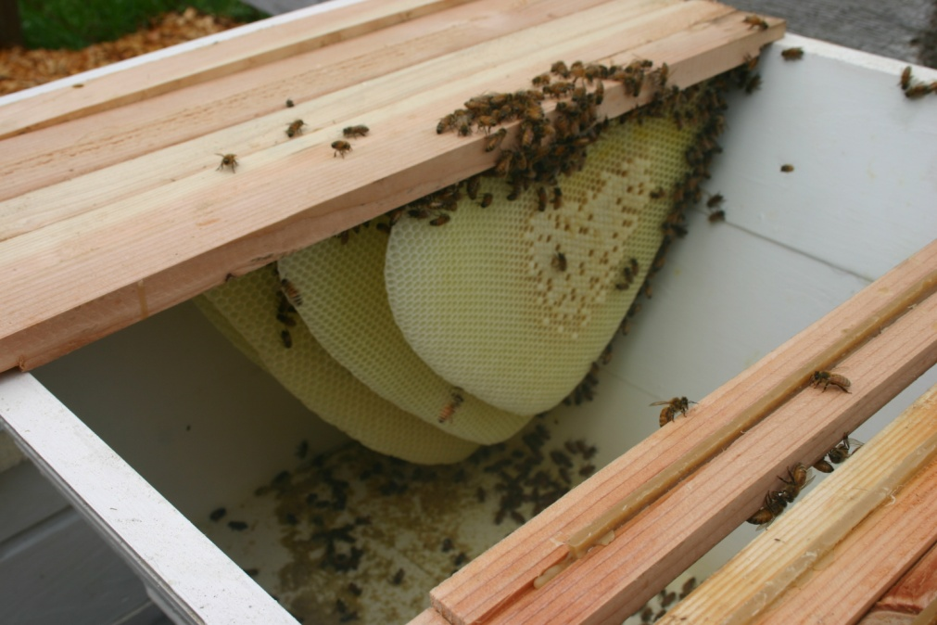
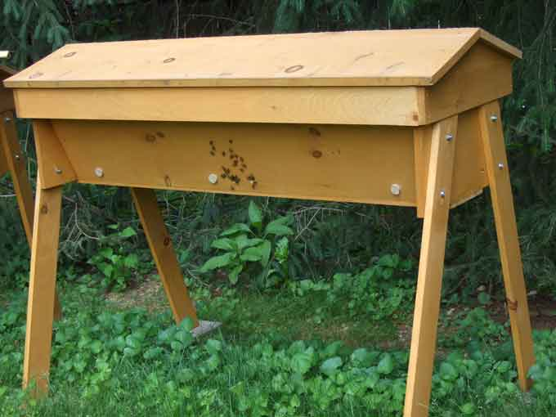
Alternative Beekeeping hives
Top Bar Hive
Differs from Langstroth Hive in design
Easy and relatively inexpensive to construct
However a little more difficult to extract honey
Render by hand to separate honey from wax; or harvest Comb or Chunk Honey

Slide 29
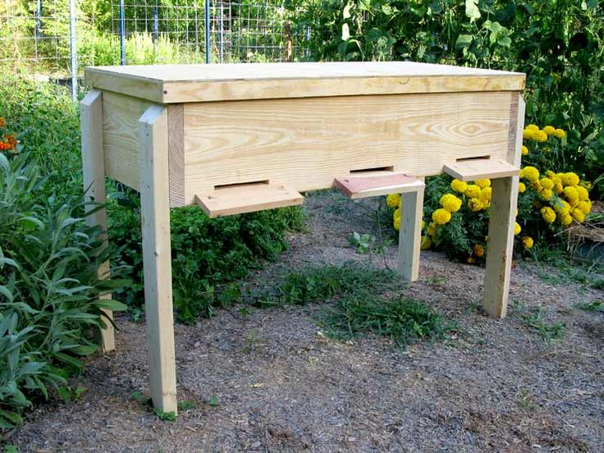
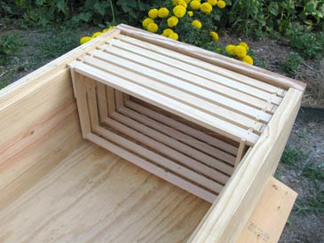
Alternatives (cont)
Horizontal Hive
Combination/Hybrid of Langstroth and Top Bar Hives
System utilizes standard frames in horizontal orientation
Standard frames are easily extracted

Slide 30
Top Bar and Langstroth Hive Comparison
Characteristic | Top Bar Hive | Langstroth | Notes
Easy on your back | RRRR | R | Height of a TBH makes it easier to work with
Hive Management | R | RRRR | Removable comb frames easier to manage
Ventilation | RR | RRR | Lang hives have chimney effect to allow heat and moisture to escape
Naturalness Factor | RRR | RR | Bees get to do their own thing when it comes to crafting honeycomb
Beauty Factor | RRRR | RR | Especially if viewing windows are added
Standardization | R | RRRR | Comb frames, supers interchangeable
Cost | RRR | R | Easy to build your own top bar hive
Harvesting Honey | RR | RRR | Frames allow use of extractor vice crushing comb to harvest honey
Moving Hives | R | RRRR | Lang hives are easy to separate and move; also allow for combining hives

Slide 31
Wrap up
Order your bees
Get and assemble your hive parts and equipment
Buy tools and protective equipment
Increase your knowledge – Register and attend Bee school
Set up your hives in good locations
Install your bees
Register your hives
Enjoy yourself and the world of beekeeping!

Slide 32
Questions
Brown County Beekeepers Association Website:
http://www.browncountybeekeepersassociation.org

